Slide 1

Computer Animation
Lab 5 - A2 - Inverse Kinematics
COMP 477

Slide 2
Preliminaries and Readings
Slides based on [Buss et al. 2004] ← I highly suggest you read this
Assignment 2
Implement 2D Inverse Kinematics with Obstacle Avoidance
Forward Kinematics:
Going from local positions and rotations to global positions and rotations
Inverse Kinematics:
Going from global positions to local positions and rotations
References
[Buss et al. 2004] Samuel R Buss. Introduction to inverse kinematics with jacobian transpose, pseudoinverse and damped least squares methods. IEEE Journal of Robotics and Automation, 17(1-19):16, 2004.

Slide 3
Assignment 2
Goal:
Implement Inverse Kinematics with Obstacle Avoidance
Instructions:
https://moodle.concordia.ca/moodle/pluginfile.php/5166842/mod_resource/content/0/A2.pdf
Github:
https://github.com/tiperiu/COMP477_A2

Slide 4
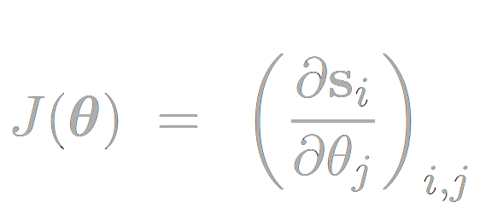
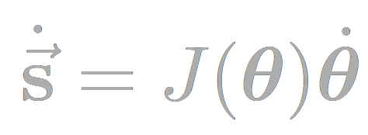
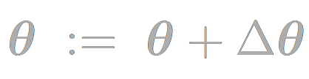
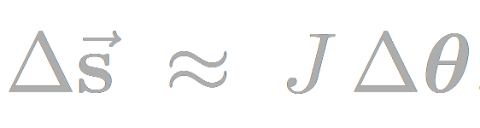
Jacobian
How much does each joint position change with each angle change?
Then, FK can be described as:
For IK, we wish to find a set of joint angles Δθ such that:
We then get:

Slide 5
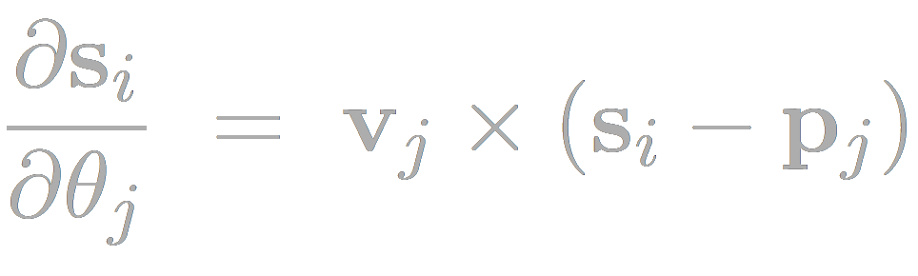
Jacobian - Calculating
When we change the angle of a rotational joint by a small ẟ, how much does the position of an end effector change?
Rotational
Axis of Rotation
Position of end effector
Position of the joint

Slide 6
Jacobian - Calculating
p₁
p₂
p₃
p₄
θ₄
p_{2,}p_{3,}
s_{x}
θ₂
J =
s_{y}
p₃
θ₃
θ₁
s
p₁

Slide 7
Jacobian - Calculating
p₁
p₂
p₃
p₄
θ₄
p_{2,}p_{3,}
s_{x}
θ₂
J =
s_{y}
p₃
θ₃
θ₁
s
(0,0,1) x (s - p₁) ← Split into x and y components
p₁

Slide 8
Jacobian - Calculating
p₁
p₂
p₃
p₄
θ₄
p_{2,}p_{3,}
s_{x}
θ₂
J =
s_{y}
p₃
θ₃
θ₁
s
(0,0,1) x (s - p₂) ← Split into x and y components
p₁

Slide 9
Jacobian - Calculating
p₁
p₂
p₃
p₄
θ₄
p_{2,}p_{3,}
s_{x}
θ₂
J =
s_{y}
p₃
θ₃
θ₁
s
(0,0,1) x (s - p₃) ← Split into x and y components
p₁

Slide 10
Jacobian - Calculating
p₁
p₂
p₃
p₄
θ₄
p_{2,}p_{3,}
s_{x}
θ₂
J =
s_{y}
p₃
θ₃
0 ← The rotation of joint 4 does not affect our end effector, thus the entries are 0. Generically, an entry is only non-zero if the given joint is a parent of the end effector.
θ₁
s
p₁

Slide 11
Jacobian - Calculating
p₁
p₂
p₃
p₄
s_{x}
J =
s_{y}
We can interpret this formula visually, it gives us a tangent in the direction of the joint’s rotation!
s
p₁

Slide 12
Jacobian - Calculating
p₁
p₂
p₃
p₄
s_{x}
J =
s_{y}
We can interpret this formula visually, it gives us a tangent in the direction of the joint’s rotation!
s
p₁

Slide 13
Jacobian - Calculating
p₁
p₂
p₃
p₄
s_{x}
J =
s_{y}
We can interpret this formula visually, it gives us a tangent in the direction of the joint’s rotation!
s
p₁

Slide 14
Jacobian - Size
For IK, our jacobian will have the following size:
num_columns = 2 * num_end_effectors
num_rows = num_rotational_joints
For A2, you need only consider a single end effector at a time (the locked joint), and the number of rotational joints is equal to the number of joints in the hierarchy - 1

Slide 15
Jacobian - Solving
Now that we have our Jacobian, which describes how the end effector moves when we move a joint, it is sufficient to invert it to give us the opposite → by how much to move the joints to get the end effectors to a given target.
But wait...
Conditions for matrix invertibility:
Square Matrix
Non-zero determinant

Slide 16
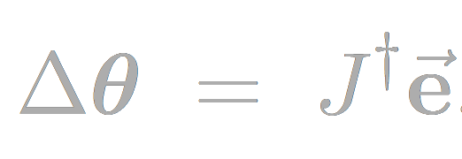
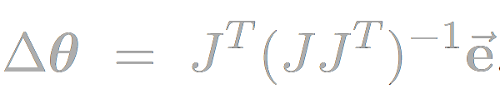
Transpose Method
Error term: vector from the end-effector to the target
Find Δθ such that:
Most “naive” method, can work ok for very simple applications, but it will be insufficient for our use case!

Slide 17
Pseudoinverse Method
Find Δθ such that:
Compute the Moore-Penrose inverse of J:
Better than the transpose method, but suffers from instabilities near singularities. System will oscillate near solution, resulting in poor performance. Still insufficient for our use case!

Slide 18
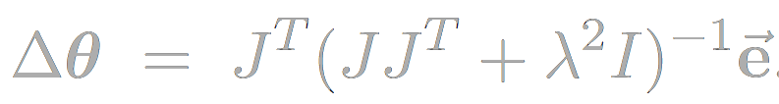
Damped Least Squares
Similar to previous mentioned pseudoinverse method, with one catch:
What is λ ?
Damping Factor
Factor that ensures numerical stability
Depends on details of your hierarchical structure
Depending on implementation, values usually in the ballpark of 5 - 50

Slide 19
Obstacle Avoidance
Next Lab…
Meanwhile, here’s a resource to get you started:
https://www.researchgate.net/profile/Anthony_Maciejewski/publication/242483646_Obstacle_Avoidance_for_Kinematically_Redundant_Manipulators_in_Dynamically_Varying_Environments/links/542ae1ed0cf27e39fa9177a3.pdf

